Slide 1
The Impact of Music Selection on Student Learning
Matt Temple, New Trier High School
Dr. Rick Jaeschke, Augustana College
Thursday, January 24, 2014
ILMEA State Conference

Slide 2
Wynton Marsalis on Music Selection
For a director, selecting music to play is the first and most crucial action.
The identity of our band is shaped more by what we play than by how well we play it.
CHOOSE WISELY…
Because only through quality music-making,
And through quality music-making practices and substantive literature will our students be challenged to go deeper inside themselves, to play above themselves, to realize more fully their individual and collective potential.
To engage in a creative dialogue across time, and to innovate with the finest minds and spirits that have ever lived.

Slide 3
Questions to ponder…
What would you play if there wasn’t a concert?
What is the ‘nutritional’ value of the music that we’re consuming?
How can daily rehearsals create deeper, more meaningful student understanding?
How can we sequence student learning from concert to concert… and year to year?

Slide 4
The Selection “Spectrum”
Needs Improvement:
Inconsistent/low quality of literature
Proficient:
High quality literature, but only tangential student learning
Excellent:
High quality literature, and intentional student learning

Slide 5
Where do we start?
Literature Lists
State lists
Teaching/Resource Guides
LIVE performances
Recordings:
Publisher Discs and Websites
Professional
You Tube
Word of Mouth
Commissioned Works

Slide 6
Comprehensive Musicianship Through Performance (CMP)
Model for planning music instruction
Created in Wisconsin in 1977
Teaching with intention…
Performing with understanding
NOT a curriculum, but a very practical framework
CMP addresses edTPA, the Danielson Evaluation Model, and the new National Core Arts Standards…

Slide 7
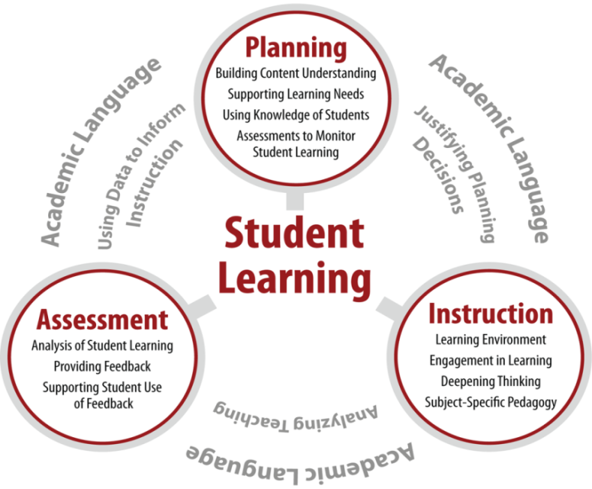

Slide 8
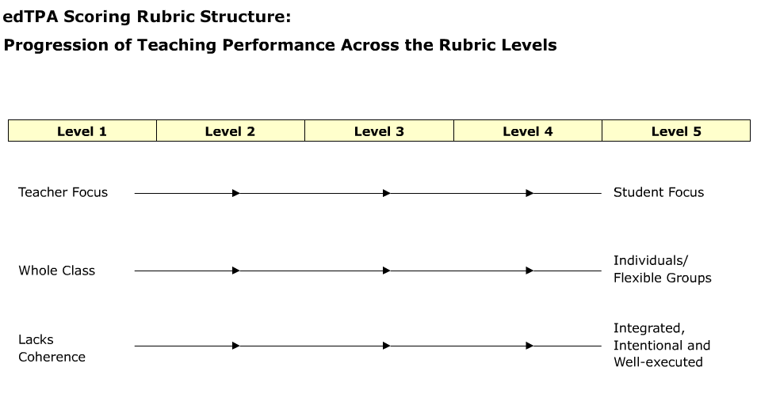
Planning is the umbrella for each lesson
Central Focus is the long-term goal that unites the learning targets.
Specific Rubrics ask the candidate to:
Make a connection to books, articles, methods.
Refer to research theory, learning theory, and make connections
☞

Slide 9
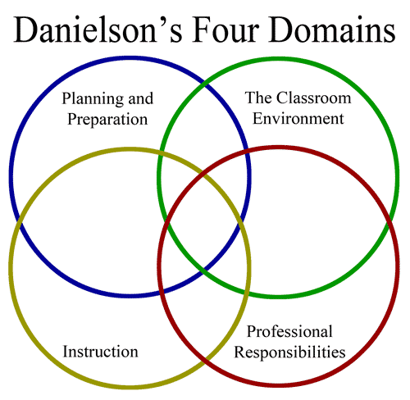

Slide 10
Danielson Model
ere
ere
1c Setting Instructional Outcomes
1. Planning
and
Preparation
1d Demonstrating Knowledge of Resources
1e Designing Coherent Instruction
ere
ere
3b Using Questioning
and
Discussion Techniques
3. Instruction
3c Engaging Students in Learning

Slide 11
A Conceptual Framework for Arts Learning
A Voluntary re-imagining of our standards foundation
Rather than offering simply a compilation of individual skills the National Core Arts Standards matrix integrates the processes, skills and knowledge, sample assessments, and criteria into a single organized structure
Move from Skills (be able to do) ➔ to ➔ student centered outcomes
Identify essential outcomes of learning
Sequential, standards-based approach
Rubrics move from Teacher guided ➔ to ➔Student Centered
Teachers are asked to Provide Artifacts
Demonstrate Growth

Slide 12
National Core Arts Standards Three (STUDENT CENTERED) Artistic Processes for Music Education
Creating | Performing | Responding
Conceiving and developing new artistic ideas and work | Realizing artistic ideas and working through interpretation and presentation | Interacting and reflecting on works and performances to develop understanding
The new standards ask us to change:
How we approach the teaching and learning process in our ensemble classrooms
Notice “classrooms” vs. “rehearsals”
How we can empower students
How students can become active and engaged thinking musicians (“musicianly roles”= CMP)
Not just Performing but the Emphasis is on process-oriented music instruction
Rehearsing for performances won’t be enough
How can we meet these standards? = CMP

Slide 13
Common Elements
The teacher demonstrates
knowledge of resources
Student learning vs.
student activity
Danielson
Framework
Move from
Teacher Directed
to
Student Centered
National Core Arts Standards
Empowering students
edTpa
Active
intellectual
student engagement
Evidence of planning lessons that support
instructional concepts
CMP
The learning process is more important than the product

Slide 14
The Five Point Model

Slide 15
Selection Criteria
Uniqueness
Form
Design (Pacing)
Depth
Orchestration/
Voicing
Unpredictability
Consistency
Transcendence
(Text)

Slide 16
Long-Term Planning

Slide 17
The BIG Picture
One Composition
Concert
Annual Cycle
Four Year Rotation

Slide 18
Programming Considerations
Historical Periods
Musical Genres
Variety of Forms
Tonal Centers, Time signatures, Tempi, etc.
Rehearsal Time
Personnel: Instrumentation, Solos, etc.
Audience and Community

Slide 19
Mistakes that we make…
But it’s my Favorite Piece!
Most Prestigious Concert
World’s Longest Concert
World’s Hardest Concert
Right length, but over-programmed

Slide 20
Programming Philosophy
Play less total music per concert
3-4 pieces for an 8-week cycle
15-20 minutes of music
Limit new music to one or none per concert
Include a minimum of two pieces of core repertoire on every concert
Difficulty: 1 easy, 1-2 at level, 1 challenge
Sight-read music that you don’t actually play in concert

Slide 21
Composition Comparison Chart (By Concert)

Slide 22
Scope and Sequence
Annual Cycle
Time of Year?
Number of Weeks to prepare?
Genres and Forms?
March
Broadway/Movie Medley
Transcription
Four-Year Rotation
Typical Course Progression through the program?
Composers?
Curricular Goals?

Slide 23
Student Learning

Slide 24
Common Vocabulary
Ensemble Concepts
Tone, intonation, balance, blend, etc.
Music Theory
Scales, intervals, chords, cadences, etc.
Music History and Culture
Period, composer’s life/background, cultural times, etc.
Define, re-define, and use it daily

Slide 25
Classroom Strategies
Warm-ups/Daily Exercises
Sight-reading
Take Out the Piece…
…written by Frank Ticheli…composed in 2005…in Sonata-Allegro form…in g minor…etc.
Composer’s Intention
Transfer of Previous Understanding
Music markings, Chalk/Dry-erase/Smart Board, Document Cam
In-class Recordings

Slide 26
Concerts that Teach
Audience Etiquette
Program Notes in the Concert Program
Pre-Concert Lecture
Students Supporting Students
Concert themes, Combined Groups
Guest Artists: Conductors, Performers, etc.
Maximum Length of Concert: 10 minutes per grade level (ex. 9th grade = 90 min)

Slide 27
Closing Thoughts

Slide 28
Paradigm Shift
Select music with a focus on quality over quantity
Create a classroom environment that values:
Process over product
Expression over perfection
Understanding over knowledge
Move from Teacher-directed to Student-centered = authentic student engagement
Teach with intentionality

Slide 29
Next Steps
Become more familiar with core repertoire
Read:
“Classic” and recent articles on music selection
Shaping Sound Musicians by Patricia O’Toole
Review your own programming:
Complete a “Composition Comparison Chart”
Create Four-Year Rotation Cycle
Commission a piece, or join a consortium
Develop your own written curriculum
Attend a CMP Summer Workshop

Slide 30
The Impact of Music Selection on Student Learning
Questions
and
Answers

